Slide 1
FINANCIAL PERFORMANCE - ORGANIZATIONAL SUSTAINABILITY RELATIONSHIP FROM AN ACCOUNTING FINANCIAL PERSPECTIVE. LITERATURE REVIEW
Phd. Mihaela Neacșu
Alexandru Ioan Cuza University of Iaşi, Faculty of Economics and Business Administration

Slide 2

Organizational sustainability efforts focus on three main areas: people, profit, and the environment (Elkington, 1997).
Sustainability has become a managerial behavior that plays an important role in contemporary organizational strategy.
By using sustainability in a more dynamic and integrated manner with management strategies, the entity responds more easily to changes in the business environment (Amui, Jabbour et al, 2017).

Slide 3

According to Cooper and Edgett (2008) "we cannot drive what we cannot measure."
In this regard, organizations that claim to implement sustainable actions or claim to be sustainable should have a system for measuring their own financial performance.
Organizations are pressured by both internal and external factors to improve their performance in organizational sustainability.

Slide 4
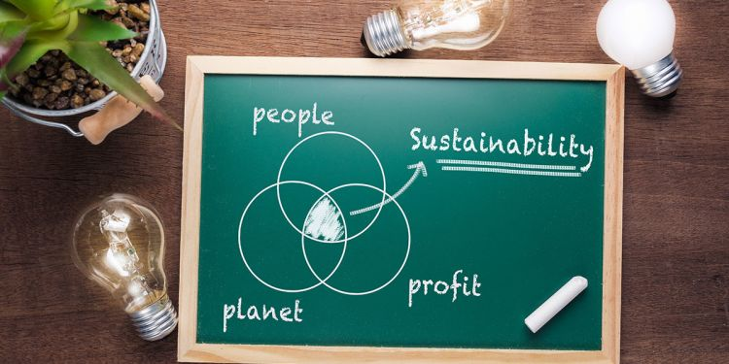
In order to identify current trends in the national and international literature regarding the analysis of the relationship between financial performance and organizational sustainability, we propose a research both quantitative and qualitative of some articles extracted from three main scientific databases: ScienceDirect, Scopus and Web of Science.

Slide 5
Starting from the fact that the objective of the research is to establish the current state of knowledge regarding organizational sustainability and financial performance, we chose as a search expression the following composite structure: "organizational sustainability" and "financial performance".
Thus, we identified 45 articles in the ScienceDirect database, 13 articles in the Scopus database and 4 articles in the Web of Science.

Slide 6
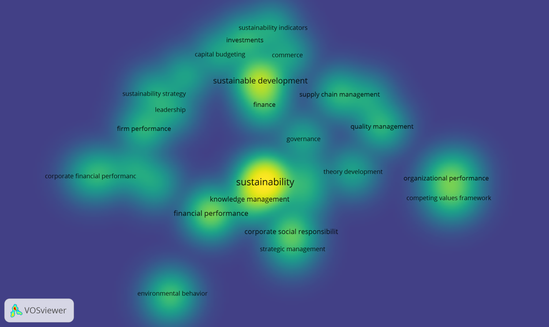

Slide 7


Slide 8
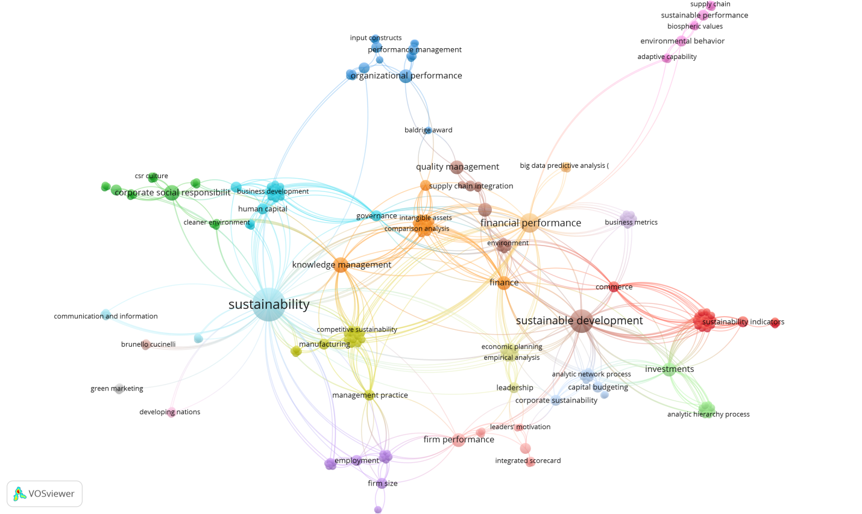

Slide 9
Domain | Researcher
Corporate sustainability | Dyck et al (2019); Abbas (2020); Stahl et al (2020); Algarni et al (2022)
Integrated sustainability | Maas et al (2016); Pavlopoulus et al (2017); Bastas & Liyanage (2018, 2019); Hussain et al (2018); Barbosa et al (2020); Beusch et al (2022)
Sustainable accounting | Lamberton (2005); Gray (2010); Contrafatto & Burns (2013); Pavlopoulus et al (2017); Büyükozkan & Karabulut (2018); Traxler et al (2020); Frost & Rooney (2021); Beusch et al (2022)
Sustainable development | Gray (2010); Lawler & Worley (2012); (Esteves et al, 2012); Journeault (2016); Afzal et al (2017); Istrate et al (2017); Wang et al (2018); Bаtistа & de Frаncisco (2018); Lueg et al (2019); Cheah et al (2019); Yusoff et al (2019); El-Kassar & Singh (2019); Traxler et al (2020); Yang et al (2020); Ren & Jackson (2020); Wahab (2021); Kavalić et al (2021); Nader et al (2022)
Social-corporate responsibility | Sharma et al (2010); Phillips et al (2019); Lin et al (2019); Martins et al (2019); Stahl et al (2020); Yang et al (2020);
Sustainable performance | Turan et al (2008); Gadenne et al (2012); Turan & Needy (2013); Jave et al (2016); Suriyankietkaew & Avery (2016); Aris et al (2016); Büyükozkan & Karabulut (2018); Eide et al (2020); Yadav et al (2020); Gupta et al (2020); Avery (2020); Ramos et al (2021); Samad et al (2021); Chʼng et al (2021); Algarni et al (2022); Dey et al (2022)
Organizational sustainability | Todoruț (2012); Birnik (2013); Pushkar & Dragunova (2016); Merriman et al (2016); Calabrese et al (2018); Hussain et al (2018); Tamayo-Torres et al (2019); Lee & Raschke (2020); Liedong et al (2022)
Organizational performance | Cho & Ahn (2018); Xu et al (2020); Scheffer et al (2021)

Slide 10

Accounting is considered the language of business, and business success is evaluated and analyzed through the prism of this language (Frost & Rooney, 2021).
Research on the relationship between accounting and sustainability appeared in the early 1990’s (Lamberton, 2005).
Accounting is becoming a very important tool, used in facilitating and creating the levers needed to implement sustainability in organizations.
Traxler et al (2020) argue that if traditional accounting optimizes economic performance, then sustainable accounting becomes a successful tool for managing and controlling the social and environmental impact of organizations.

Slide 11

CONCLUSIONS
The accounting sector, in practice, has been easily engaged in organizational sustainability issues (Burritt & Tingey-Holyoak, 2011).
If sustainability issues will be part of future accounting practices, then relevant research is needed to insert these practices into the economic activity of entities.
Accounting strategies should provide information on substitute products and services.
Significant accounting techniques used to implement organizational sustainability must focus on innovation and creativity (Schaltegger, Bennett, Burritt, & Jasch, 2008).

Slide 12
BIBLIOGRAPHY
Abbas, J. (2020). Impact of total quality management on corporate sustainability through the mediating effect of knowledge management. Journal of Cleaner Production , 244, 1-11.
Afzal, F., Lim, B., & Prasad, D. (2017). An investigation of corporate approaches to sustainability in the construction industry. Procedia Engineering , 180, 202-210.
Albu C., Albu N. (2004). Instrumente de management al performanței. București: Editura Economică.
Algarni, M., Ali, M., Albort-Morant, G., Leal-Rodríguez, A., Latan, H., Ali, I., și alții. (2022). Make green, live clean! Linking adaptive capability and environmental behavior with financial performance through corporate sustainability performance. Journal of Cleaner Production , 1-54.
Amui, L., Jabbour, C., & de Sousa Jabbour, A. (2017). Sustainability as a dynamic organizational capability: A systematic review and a future agenda toward a sustainable transition. Journal of Cleaner Production , (142), 308-322.
Aris, N., Othman, R., Chik, W., & Rahman, S. (2016). Creating a Culture of Sustainability using Mission Statements of Cooperative Organizations. Environment-behaviour proceedings journal , 1, 387-393.
Avery, A. (2020). After the disclosure: measuring the short-term and long-term impacts of data breach disclosures on the financial performance of organizations. Information and Computer Security , 29, 500-525.
Barbosa, M., Castaneda -Ayarza, J., & Lombardo Ferreira, D. (2020). Sustainable Strategic Management (GES): Sustainability in small business. Journal of Cleaner Production , 258, 1-11.
Bastas, A., & Liyanage, K. (2019). Integrated quality and supply chain management business diagnostics for organizational sustainability improvement. Sustainable Production and Consumption , 17, 11-30.
Bastas, A., & Liyanage, K. (2018). Sustainable supply chain quality management: A systematic review. Journal of Cleaner Production , 181, 726-744.
Batista, A., & de Francisco, A. (2018). Organizational Sustainability Practices: A Study of the Firms Listed by the Corporate Sustainability Index. Sustainability , 10, 1-13.
Beusch, P., Frisk, J., Rosén, M., & Dilla, W. (2022). Management control for sustainability: Towards integrated systems. Management Accounting Research , 54, 1-14.
Birnik, A. (2013). Developing climate change strategy: A framework for managers. Thunderbird International Business Review , 55, 699-717.
Bogliolo F. (2000). La création de valeur. Paris: Éditions dʼOrganisation.
Burritt, R., & Schaltegger, S. (2010). Sustainability accounting and reporting: fad or trend? Accounting, Auditing & Accountability Journal , (23), 829-846.
Burritt, R., & Tingey-Holyoak, J. (2011). Sustainability accounting research and professional practice: mind the gap. În B. R. Evans E., Bridging the Gap between Academic Accounting Research and Professional Practice (pg. 112-130). Sydney: The Institute of Chartered Accountants in Australia.
Burritt, R., Herzig, C., Schaltegger, S., & Viere, T. (2019). Diffusion of environmental management accounting for cleaner production: Evidence from some case studies. Journal of Cleaner Production , 224, 479-491.
Büyükozkan, G., & Karabulut, Y. (2018). Sustainability performance evaluation: Literature review and future directions. Journal of Environmental Management , 217, 253-267.
Calabrese, A., Forte, G., & Ghiron, N. (2018). Fostering sustainability-oriented service innovation (SOSI) through business model renewal: The SOSI tool. Journal of Cleaner Production , 201, 783-791.
Ch’ng, P.-C., Cheah, J., & Amran, A. (2021). Eco-innovation practices and sustainable business performance: The moderating effect of market turbulence in the Malaysian technology industry. Journal of Cleaner Production , 283, 1-11.
Cheah, J., Amran, A., & Yahya, S. (2019). Internal oriented resources and social enterprises’ performance: How can social enterprises help themselves before helping others? Journal of Cleaner Production , 211, 607-619.
Cho, H.-J., & Ahn, J.-Y. (2018). The dark side of wars for talent and layoffs: Evidence from Korean firms. Sustainability , 10, 1-18.
Contrafatto, M., & Burns, J. (2013). Social and environmental accounting, organisational change and management accounting: A processual view. Management Accounting Research , 24, 349-365.
Cooper, R., & Edgett, S. (2008). Maximizing productivity in product innovation. Research-Technology Management , 51, 47-58.
da Silva Batista, A., & de Francisco, A. (2018). Organizational Sustainability Practices: A Study of the Firms Listed by the Corporate Sustainability Index. Sustainability , (10), 1-13.
Dey, M., Bhattacharjee, S., Mahmood, M., Uddin, M., & Biswas, S. (2022). Ethical leadership for better sustainable performance: Role of employee values, behavior and ethical climate. Journal of Cleaner Production , 337, 1-11.
Drucker, P. (1988). The Coming of the New Organization. Harvard Business Review , 1-12.
Dyck, B., Walker, K., & Caza, A. (2019). Antecedents of sustainable organizing: A look at the relationship between organizational culture and the triple bottom line. Journal of Cleaner Production , 231, 1235-1247.
Eide, A., Saether, E., & Aspelund, A. (2020). An investigation of leaders’ motivation, intellectual leadership, and sustainability strategy in relation to Norwegian manufacturers’ performance. Journal of Cleaner Production , 254, 1-12.
El-Kassar, A.-N., & Singh, S. (2019). Green innovation and organizational performance: The influence of big data and the moderating role of management commitment and HR practices. Technological Forecasting & Social Change , 144, 483-498.
Elkington, J. (1997). Cannibals with forks: The triple bottom line of the 21st Century. Environmental Quality Management , 37-51.
Esteves, F., Santos, J., & Anunciação, P. (2012). Sustainability in the Information Society: A Proposal of Information Systems Requirements in View of the DPOBE Model for Organizational Sustainability. Procedia Technology , 5, 599 – 606.
Frost, G., & Rooney, J. (2021). Considerations of sustainability in capital budgeting decision-making. Journal of Cleaner Production , 312, 1-13.
Gadenne, D., Mia, L., Sands, J., Winata, L., & Hooi, G. (2012). The influence of sustainability performance management practices on organisational sustainability performance. Journal of Accounting and Organizational Change , 8, 210-235.
Gray, R. (2010). Is accounting for sustainability actually accounting for sustainability...and how would we know? An exploration of narratives of organisations and the planet. Accounting, Organizations and Society , 35, 47-62.
Gupta, S., Drave, V., Dwivedi, Y., Baabdullah, A., & Ismagilova, E. (2020). Achieving superior organizational performance via big data predictive analytics: A dynamic capability view. Industrial Marketing Management , 90, 581-592.
Hussain, T., Edgeman, R., Eskildsen, J., Shoukry, A., & Gan, S. (2018). Sustainable Enterprise Excellence: Attribute-Based Assessment Protocol. Sustainability , 11, 1-13.
Hjorth, P., & Bagheri, A. (2006). Navigating towards sustainable development: A system dynamics approach. Futures , (38), 74-92.
International Institute for Sustainable Development (IISD). (1992). Business Strategy for Sustainable Development: Leadership and Accountability for the ‘90s. Winnipeg, Canada.
Istrate, C., Robu, I.-B., Pavaloaia, L., & Herghiligiu, I. (2017). Analysis of companies sustainability under the influence of environmental information disclosure. Environmental Engineering and Management Journal , 16, 957-967.
Javed, M., Rashid, M., & Hussain, G. (2016). When does it pay to be good e A contingency perspective on corporate social and financial performance: would it work? Journal of Cleaner Production , 1062-1073.
Jennings, P., & Zandbergen, P. (1995). Ecologically Sustainable Organizations: An Institutional Approach. Academy of Management Review , (20), 1015-1052.
Jianu I. (2007). Evaluarea, prezentarea și analiza performanței întreprinderii. București: Editura CECCAR.
Journeault, M. (2016). The Integrated Scorecard in support of corporate sustainability strategies. Journal of Environmental Management , 182, 214-229.
Yadava, G., Kumar, A., Luthrac, S., Garza-Reyes, J., Kumar, V., & Batista, L. (2020). A framework to achieve sustainability in manufacturing organisations of developing economies using industry 4.0 technologies’ enablers. Computers in Industry , 122, 1-13.
Yang, Y., Lau, A., Lee, P., & Cheng, T. (2020). The performance implication of corporate social responsibility in matched Chinese small and medium-sized buyers and suppliers. International Journal of Production Economics , 230, 1-12.
Yusoff, Y., Omar, M., & Zaman, M. (2019). Do all elements of green intellectual capital contribute toward business sustainability? Evidence from the Malaysian context using the Partial Least Squares method. Journal of Cleaner Production , 234, 626-637.

